Slide 1


Quick Learning App
SPRING 2023 CAPSTONE PROJECT
GUIDED BY:- Prof. Henry Wong

Slide 2

Agenda:
Feedback
Accountabilities
Project Description
Team Working Agreement
Personas
MVP
Technologies
Algorithms
Diagrams
Sprint Recap
Product Backlog
Sprint Backlog
User stories
Test cases
Metrics
Retrospective
Stories committed for Sprint 5
App Demo

Slide 3




Accountabilities:
Amit Bhayal
Ankush Gurhani
Genius Machado
Software Developer
Software Developer
Software Developer

Slide 4



Accountabilities:
Sharanya Dave
Sravani Eata
Usha Sri Tirumalasetty
SDE3 / Database Administrator
Business Analyst/Software Tester
SDE 2/Software Tester

Slide 5
Improvements Made:
Story Points for the tasks given and added the priority column in the Product Backlog.
Sprint Backlog was renamed to Sprint 5 Backlog OR Current Sprint Backlog.
Appropriate scenarios were added to the user stories.
Committed work was removed from the team velocity chart.
Redefined the retrospective by removing the action items.

Slide 6

Project Description:
Quick Learning is a web-based technology used to plan, implement, and assess a specific learning process.
Typically, QL provides an instructor with a platform to create and deliver content, manage registration and enrollment, track student progress and assessment, and deliver educational material.
It also provides students with access to course materials, assignments, and assessments. The main goal QL is to automate and streamline the administration, tracking, reporting, and delivery of educational courses or training programs.

Slide 7
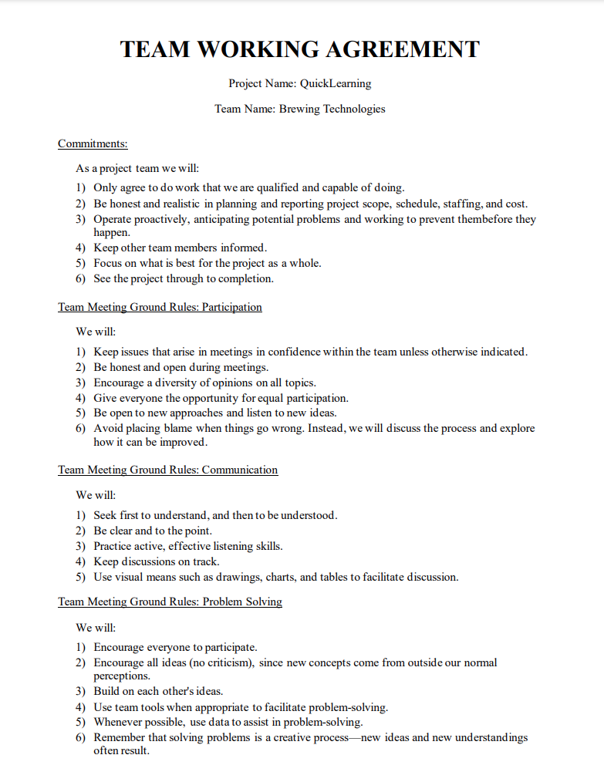
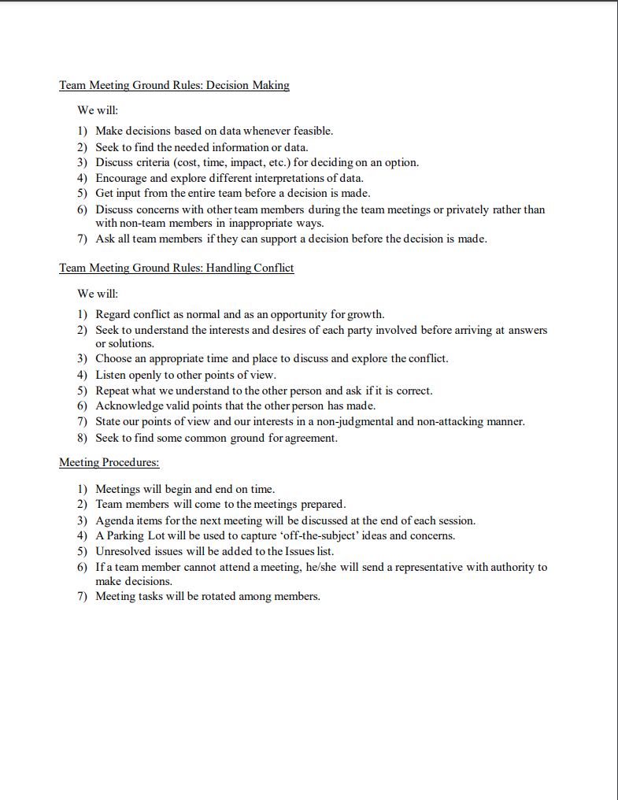

Slide 8


Personas

Slide 9
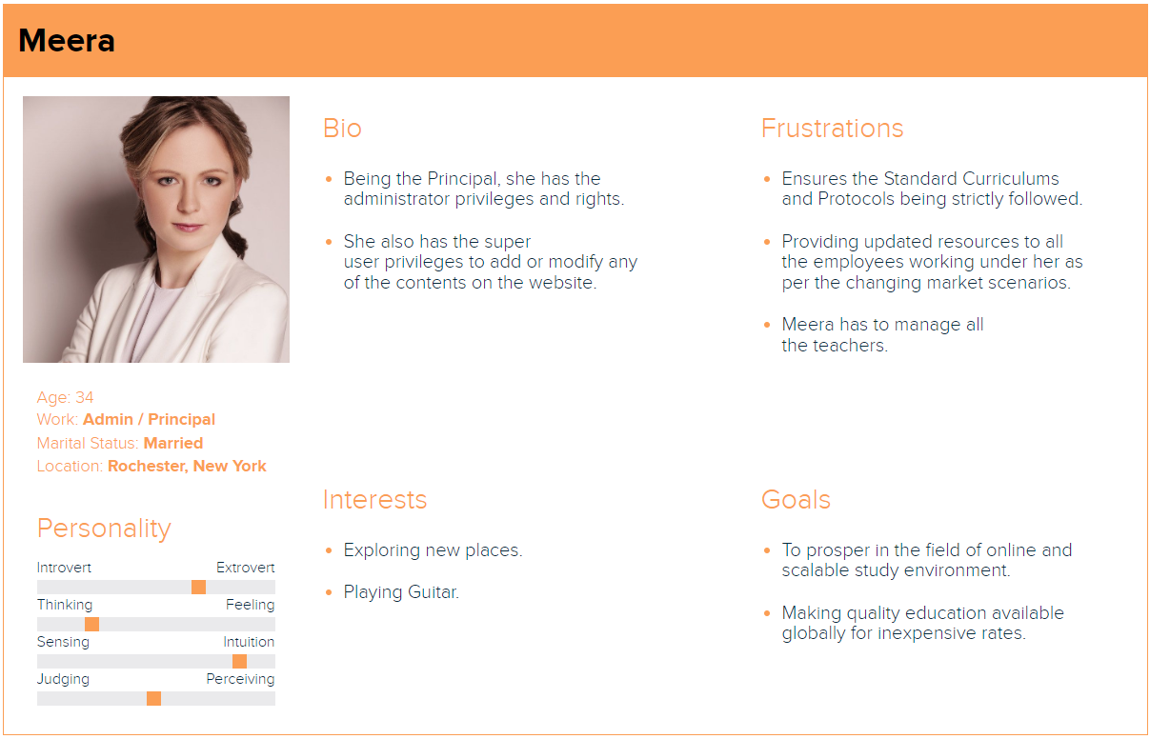

Slide 10
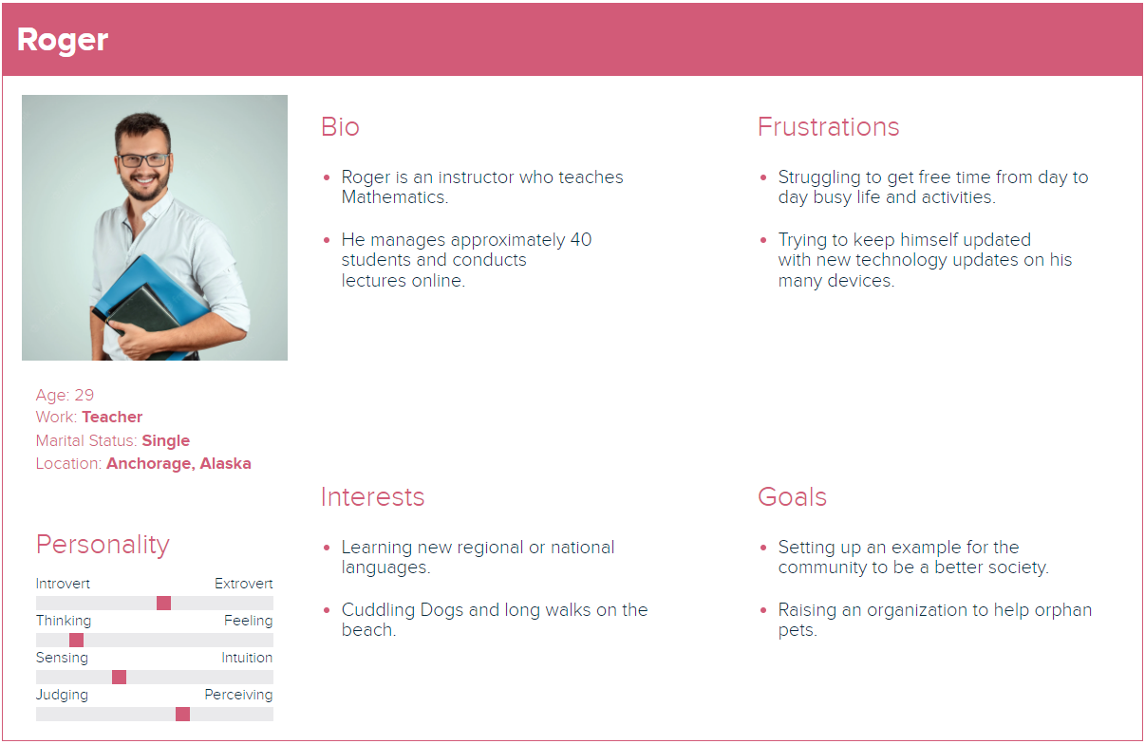

Slide 11
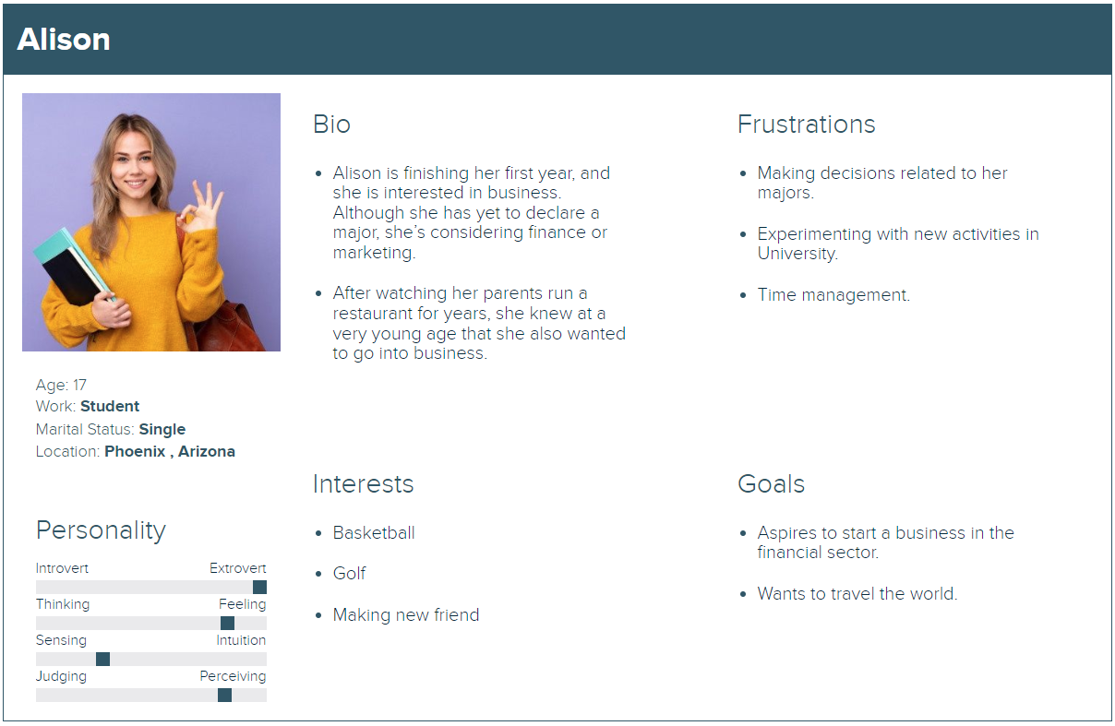

Slide 12
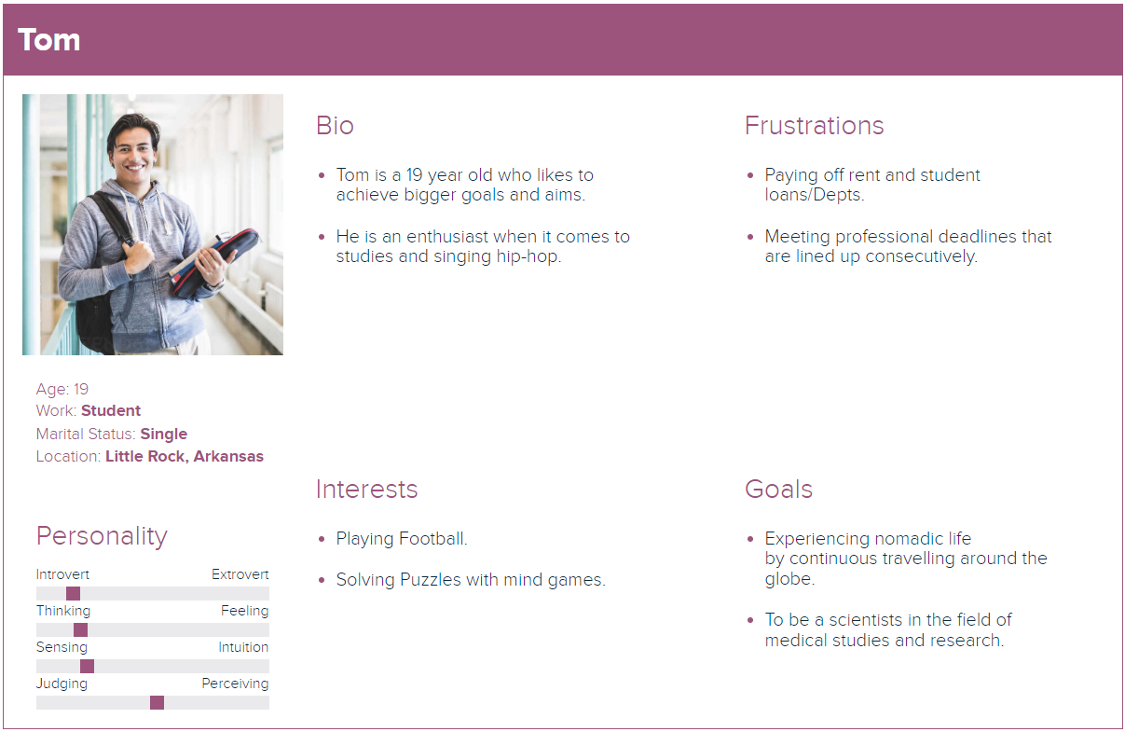

Slide 13

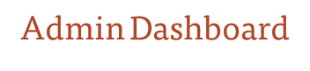

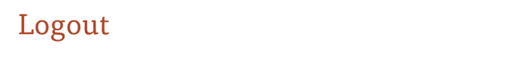
Minimal Viable Product(MVP):
Registration/Signup
User can register into application.
Add and delete course for the Admin.
Login
User can login into the application with valid credentials.
Minimal settings page for admin & enrolment of a student.
User can view the course.
User can Logout from the application.
Instructor Page
Instructor can add course through this page.

Slide 14
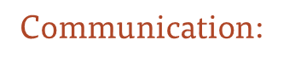











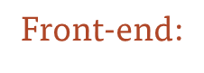




Technologies:
Database:
Back-end:
Code editor:
Project Tracking:
Visual Studio

Slide 15
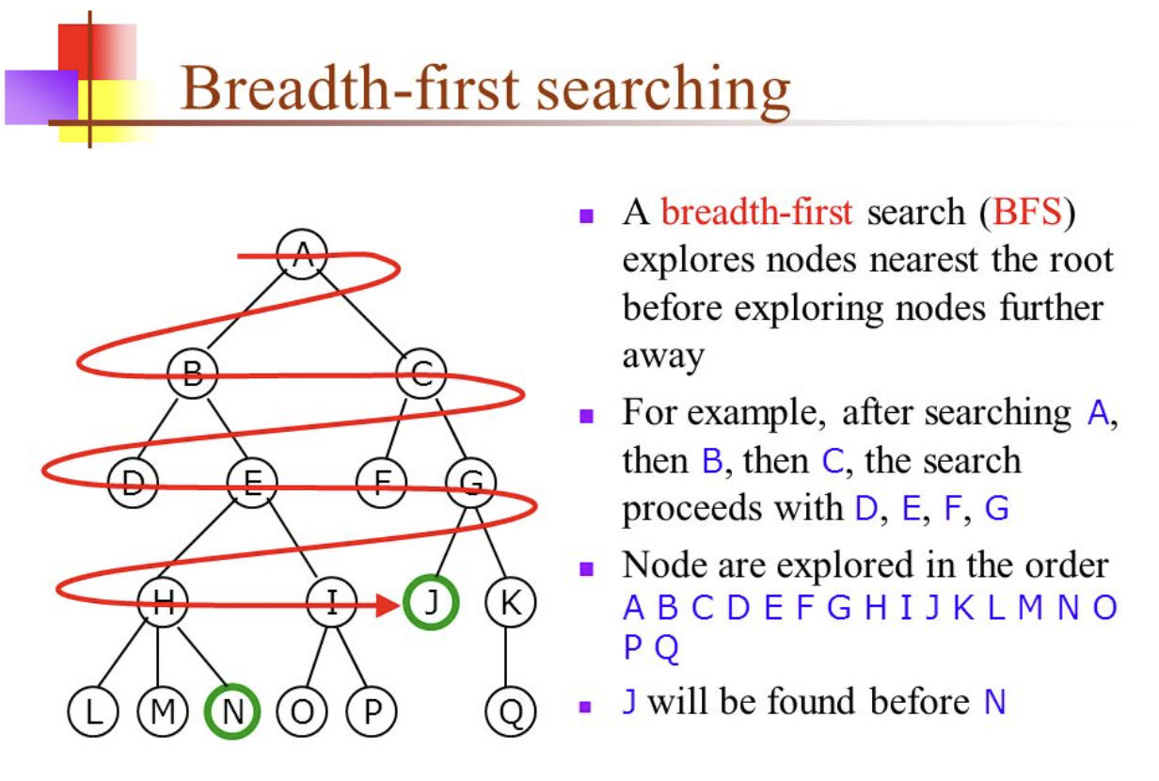
Algorithm:

Slide 16
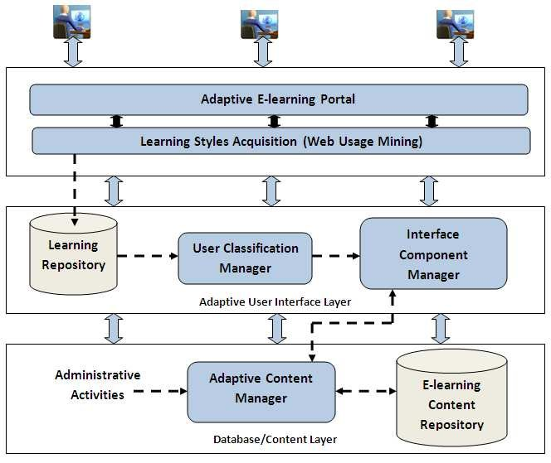
Conceptual Architecture Diagram:

Slide 17
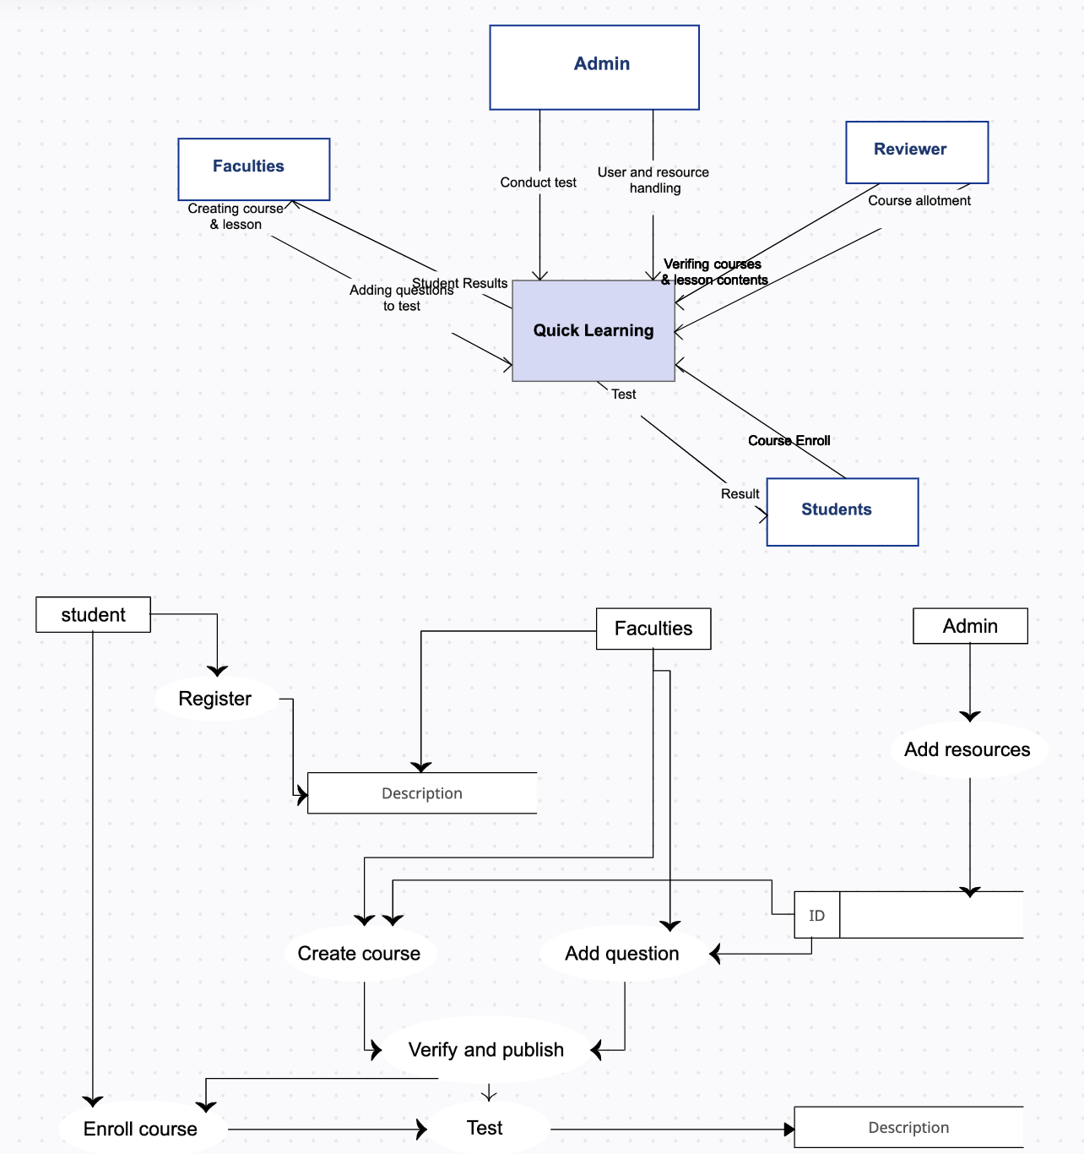
Context Diagram:

Slide 18
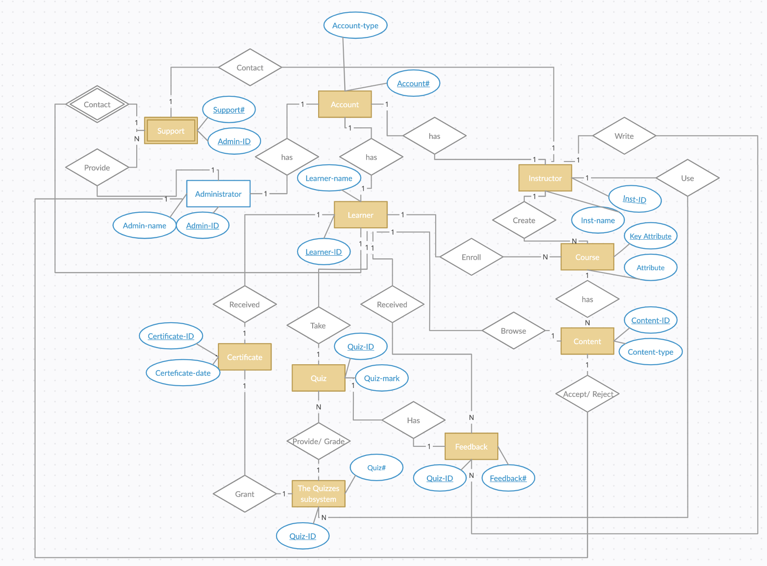
ER Diagram:

Slide 19
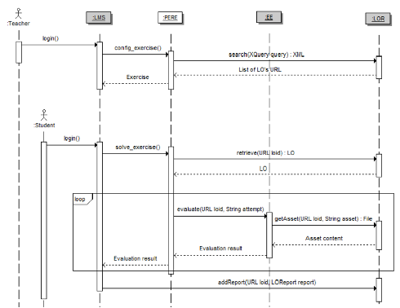
Sequence Diagram

Slide 20
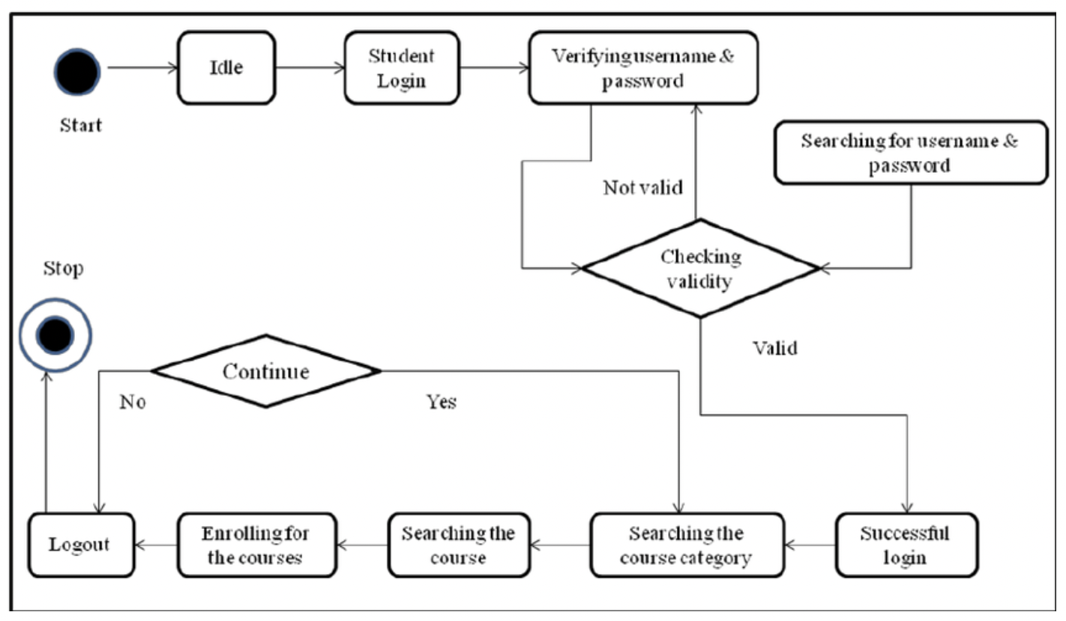
State Diagram :

Slide 21
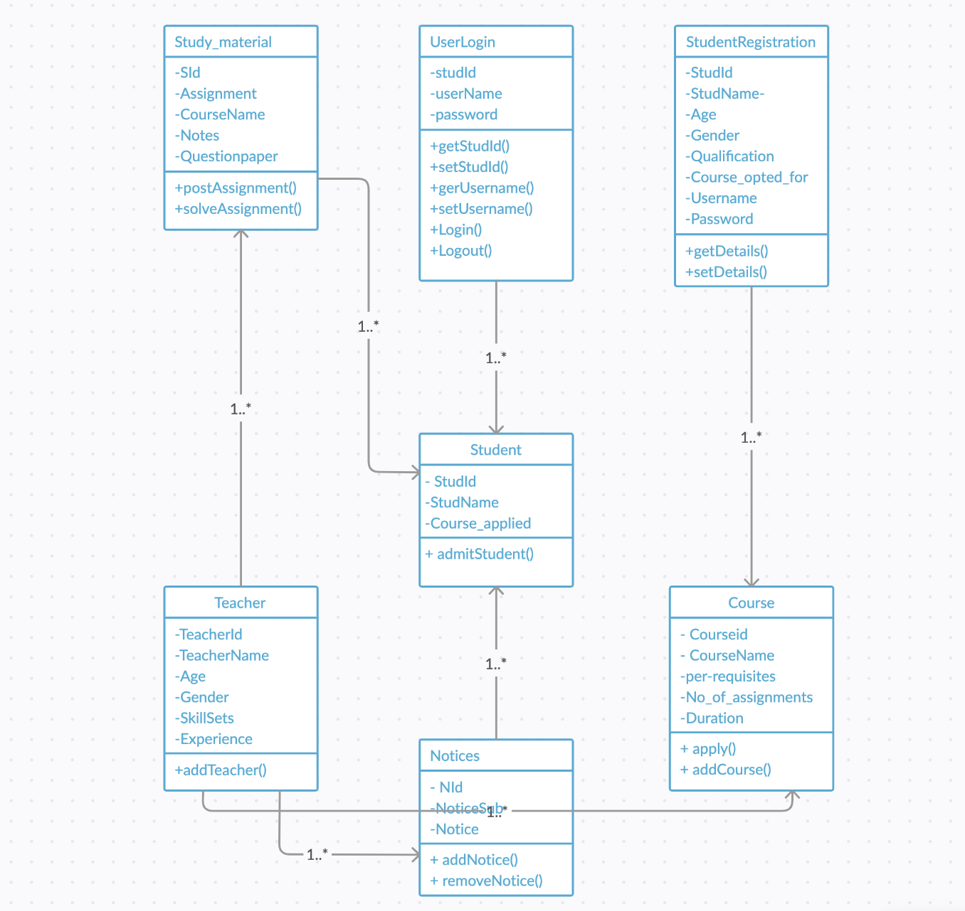
Class Diagram :

Slide 22
Application Modeling:
Admin
Departments, Courses, Professors, and Students list.
Maintaining and monitoring the professors and student's profile.
Communication channels.
Maintaining and monitoring courses content up-to-date.
Looking into Accounts.
Professor
Upcoming schedules.
List of courses.
Attend live classes.
Uploading course related contents.
Uploading assignments, quizzes and exams.
Give marks and feedbacks.
Monitoring the student's progress.
Conduct Study hours.
Special Classes.
Communication channels.
Quick Learning App
Authentication & Authorization
Student
List of courses.
Weekly schedule.
Personal profile.
Upload assignments, write exams, submit quizzes.
Marks.
Achievements.
Workshops.
Badges.
Certifications.
Downloads.
Important (OR) Saved materials.
Handshake.
Communication channels.
Courses payment details.

Slide 23
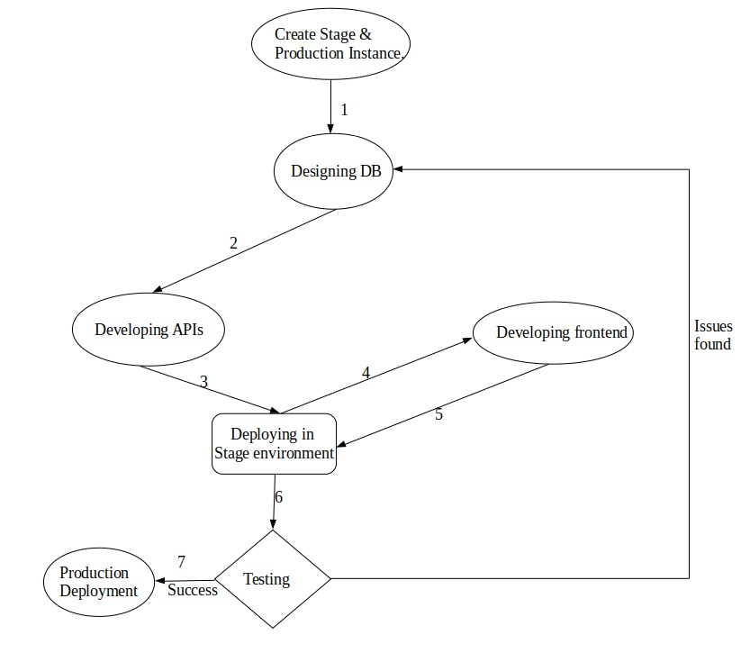







Software Development Cycle:

Slide 24
SPRINT 4 RECAP:
Wishlist.
Messages.
Top 10 courses.
Guest profile.
PROJECT RECAP:
SignUp
Login
Logout
Create My Account
Update My Account
Forgot password
Add Course
List Course
Delete Course
Course Details
Course Wishlist​
Messages
Top 10 courses
Guest Profile

Slide 25
Product Backlog:
Id | Issue Type | Story | Status | Story Points | Priority
BREW-107 | Task | Need to encrypt the password while storing in Database. | To-do | 3 | Medium
BREW-108 | Story | As a Student, I want to do the payment so that I can join or able to see the class of the course that I want to learn. | To-do | 8 | Medium
BREW-109 | Story | As a user I want faster loading pages So that I don’t have to wait for the pages to load. | Done | 1 | High
BREW-131 | Story | As a user, I want the content in my language because it is convenient for me. | Done | 5 | High
BREW-112 | Story | As a User, I want to see the notifications, so that I can be able to know the updates. | To-do | 3 | Low
BREW-117 | Story | As a student, I want to check my grades, so that I will know my progress. | To-do | 5 | Low
BREW-129 | Story | As a Professor, I want to upload the materials for the course, so that students can revise everything that I taught. | To-do | 5 | Medium
BREW-130 | Story | As a Student, I want to able to see the materials, so that I can revise everything. | To-do | 3 | Medium

Slide 26
Product Backlog:
Id | Issue Type | Story | Status | Story Points | Priority
BREW-132 | Story | As a Student, I want to download the materials, so that I can see them offline as well. | To-do | 3 | Low
BREW-133 | Story | As a Professor, I want upload assignments, so that I can check the student's knowledge of my course. | To-do | 5 | Low
BREW-134 | Story | As a Student, I want to submit assignments, so that I professor can see my answers. | To-do | 5 | Low
BREW-137 | Story | As an admin I want to change my system setting. So that I can change the website name | Done | 8 | High

Slide 27
Sprint 5 Backlog:
UserStories ID | Summary | Story Point
BREW-109 | As a user I want faster loading pages So that I don’t have to wait for the pages to load | 1
BREW-131 | As a user I want to view the website in my language So that I can understand it easily | 5
BREW-137 | As an admin I want to change my system setting. So that I can change the website name | 8

Slide 28
User Stories:
User Story Id | Summary | Status
BREW-109 | As a user I want faster loading pages So that I don’t have to wait for the pages to load | Done
 | Scenario The student wants to visit the next page Given the student is logged in using the correct credentials When the link to the next page is clicked Then the page should be pre-loaded for the user
BREW-131 | As a user I want to view the website in my language So that I can understand it easily | Done
 | Scenario The student is from other an country Given the student is logged in using the correct credentials When the student clicks the button to change the language Then the language of the webpage should be changed
BREW-137 | As an admin I want to change my system setting. So that I can change the website name | Done
 | Scenario The admin wants to change the name of the website Given the admin is logged in using the correct credentials When the admin goes to system setting Then they can change the change the name of the website

Slide 29
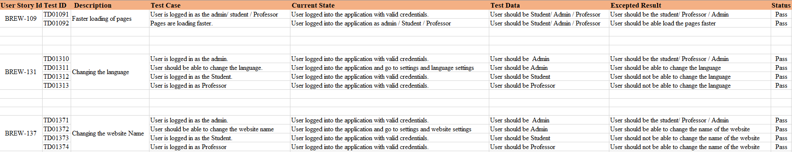
Test Cases:

Slide 30
Stories Completed and Stories Not Completed
UserStory ID | Summary | Story Point | Status
 |  | 1 | Completed
 |  | 5 | Completed
 |  | 8 | Completed
BREW-109
As a user I want faster loading pages So that I don’t have to wait for the pages to load
BREW-131
As a user I want to view the webpage in my language So that I can understand it better
BREW-137
As an admin I want to change my system setting. So that I can change the website name

Slide 31
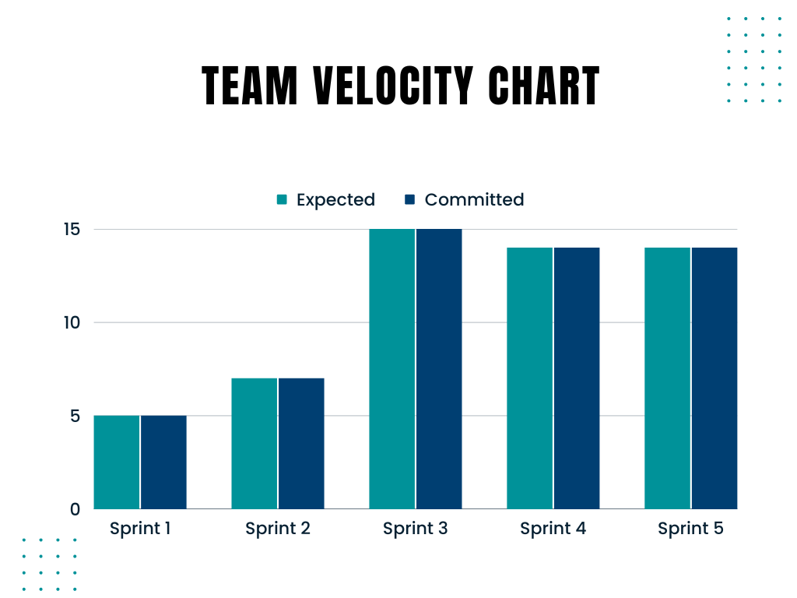
Team Velocity Chart:

Slide 32
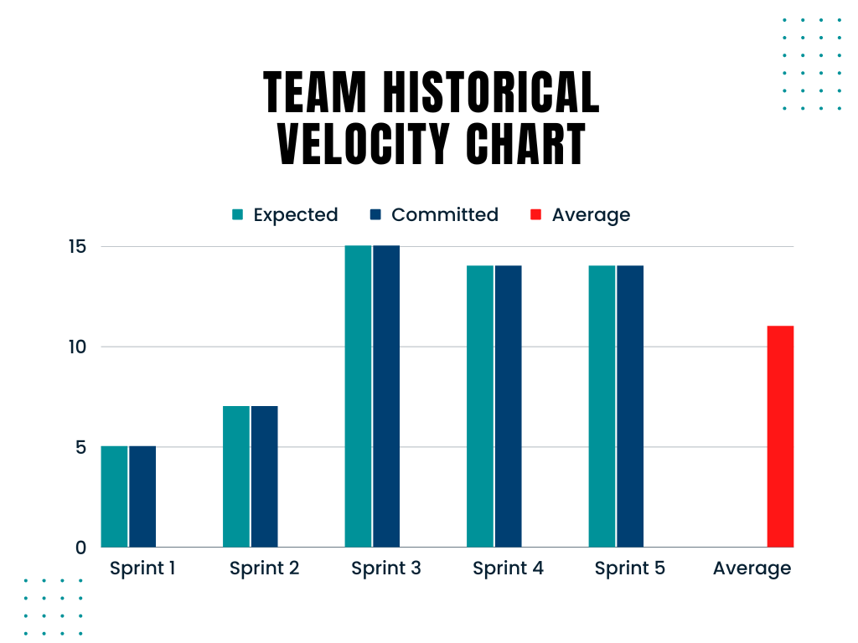
Team Historical Velocity (Average):

Slide 33
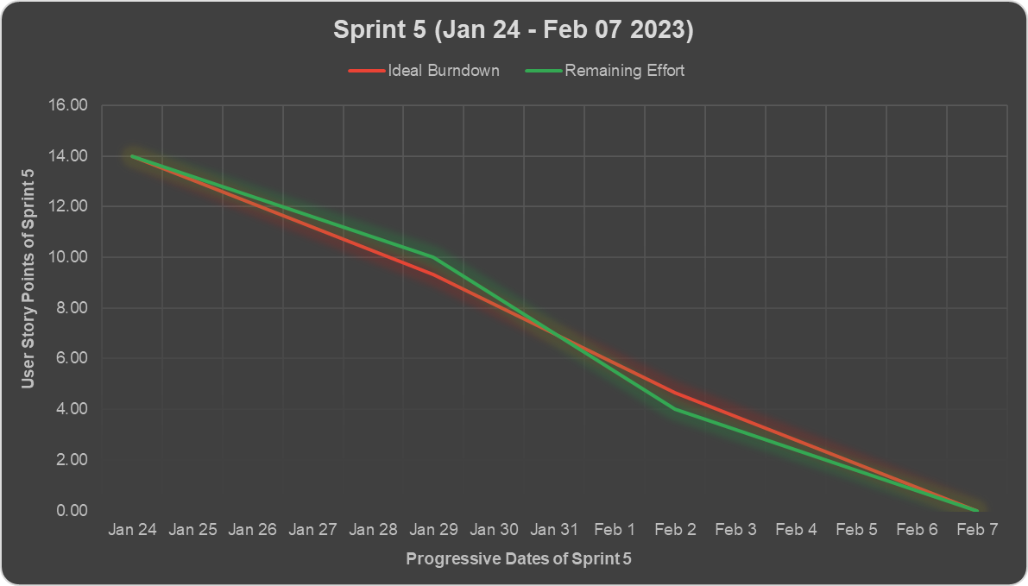
Burndown Chart:

Slide 34
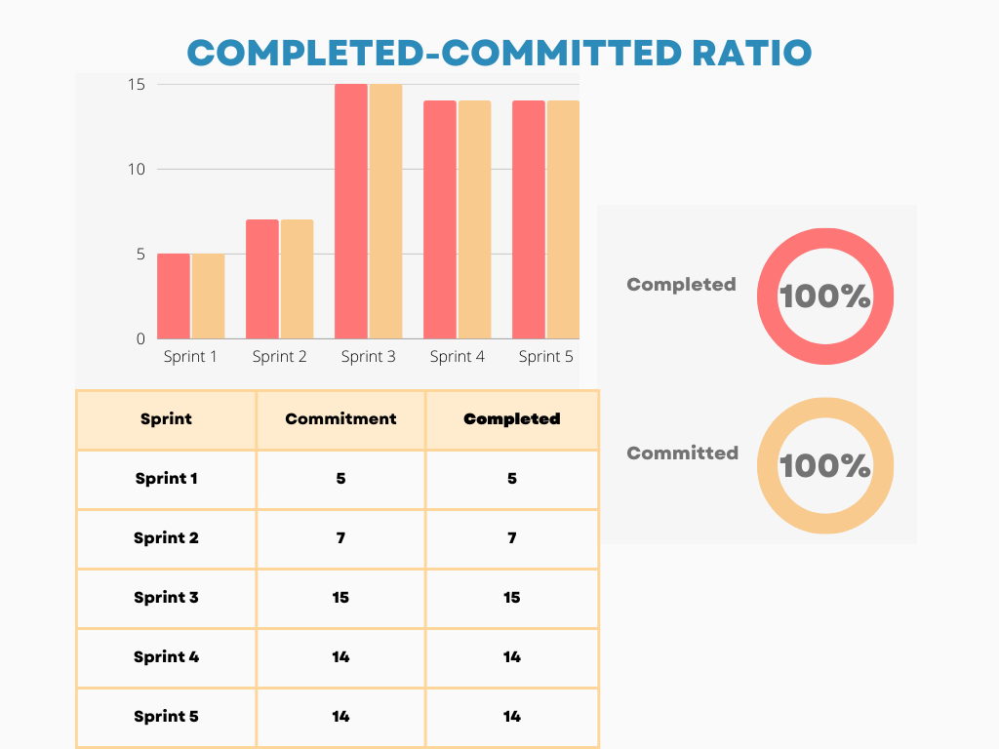
Committed Against Completed Ratio:

Slide 35
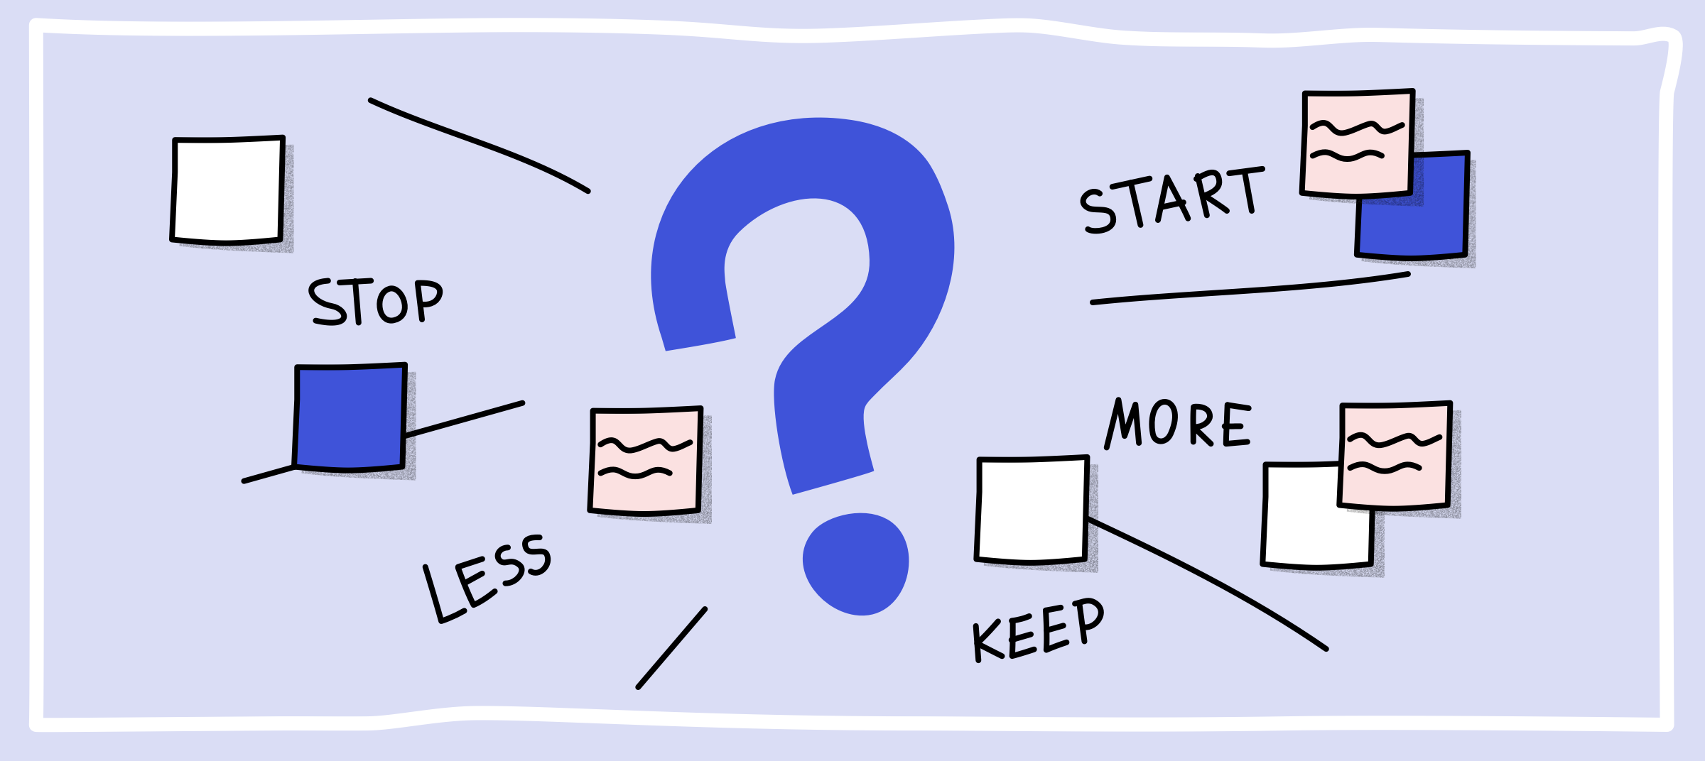
Retrospective

Slide 36
What went well?
Improved team productivity.
We are excited as the team to move forward and work on deliverables.
Better communication among the team members.
Better anticipation of future problems.
Time Management is efficient.
All members knew what they had to do — and did it!
Backlog items are Prioritized and worked accordingly.

Slide 37
What didn’t go well?
We have not reached our testing goals.
Changing the user stories late in the sprint.
Unexpected bugs raised as the unit testing is not proper.
Took more than expected time to complete the User stories.
Use more accurate ways to estimating the story size.

Slide 38
What needs improvement?
Get better at estimating
User testing should be better to avoid the bugs.
Should have the clear understanding of the User Stories.
Set time in each sprint for knowledge sharing.
Time Mangement should be efficient.

Slide 39
Stories Planned and Committed for Sprint 6:
Story_ID | Stories | Status
BREW-107 | Need to encrypt the password while storing in Database. | To-do
BREW-108 | As a Student, I want to do the payment so that I can join or able to see the class of the course that I want to learn. | To-do
BREW-112 | As a User, I want to see the notifications, so that I can be able to know the updates. | To-do
BREW-132 | As a Professor, I want to upload the materials for the course, so that students can revise everything that I taught. | To-do
BREW-133 | As a Student, I want to able to see the materials, so that I can revise everything. | To-do
BREW-134 | As a Student, I want to download the materials, so that I will be able to access them offline too. | To-do

Slide 40
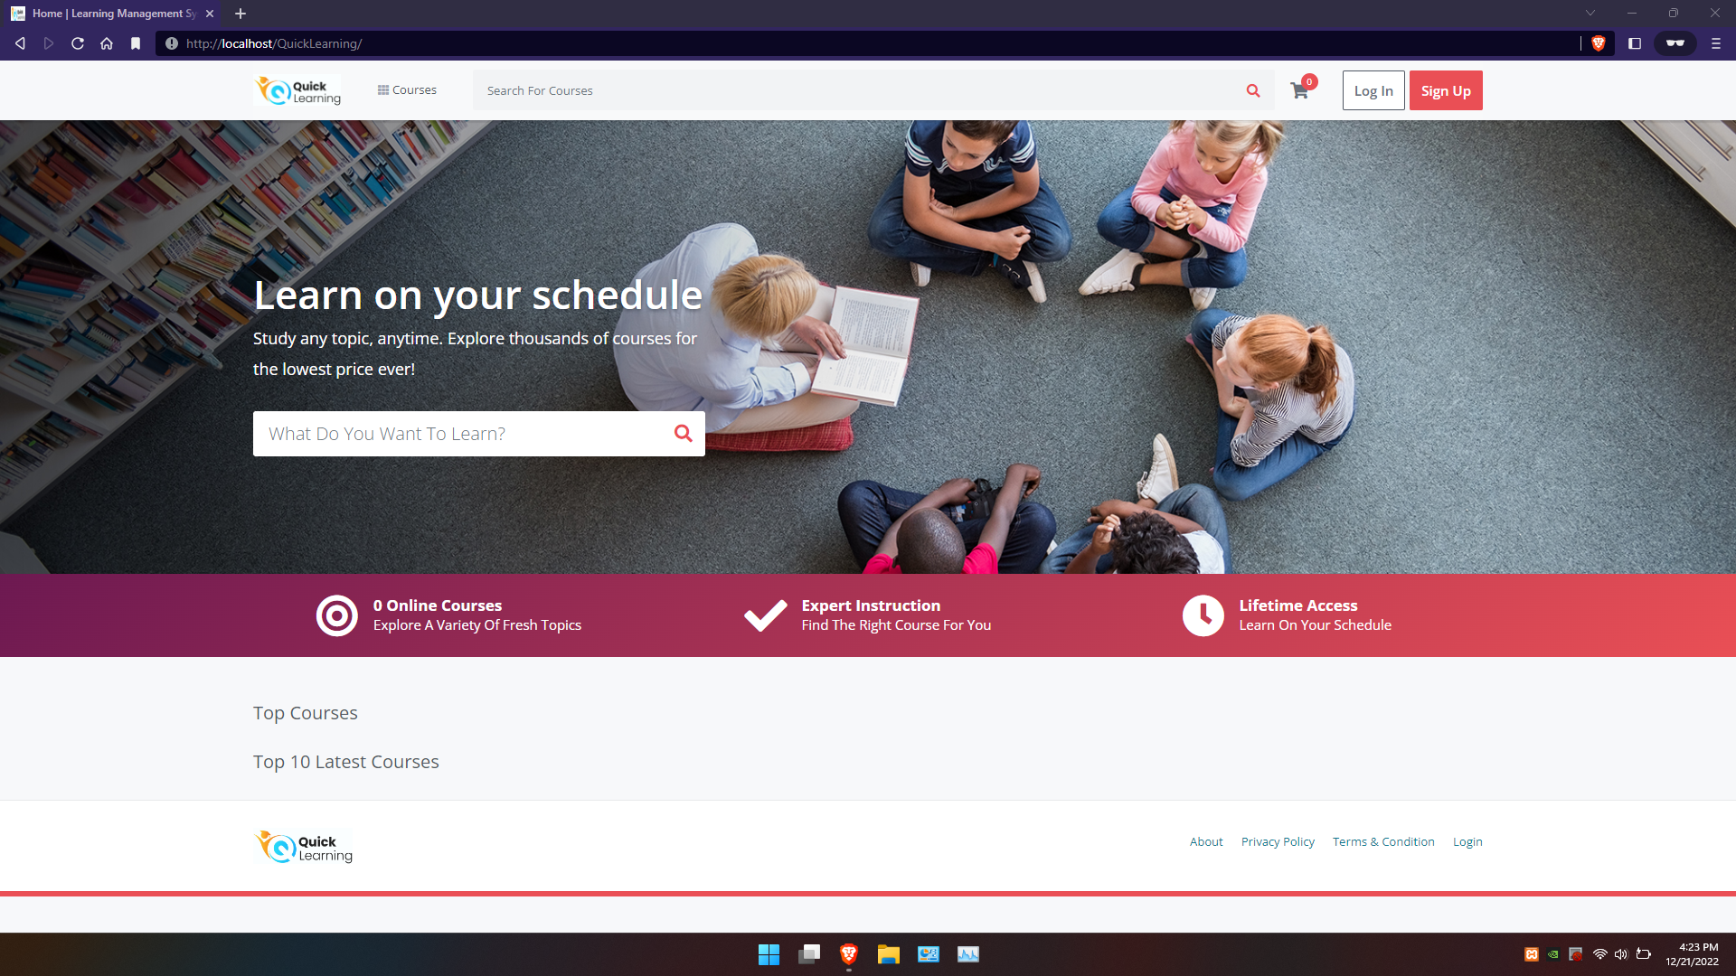
Slides App Screenshot
Front Page with search functionality.

Slide 41
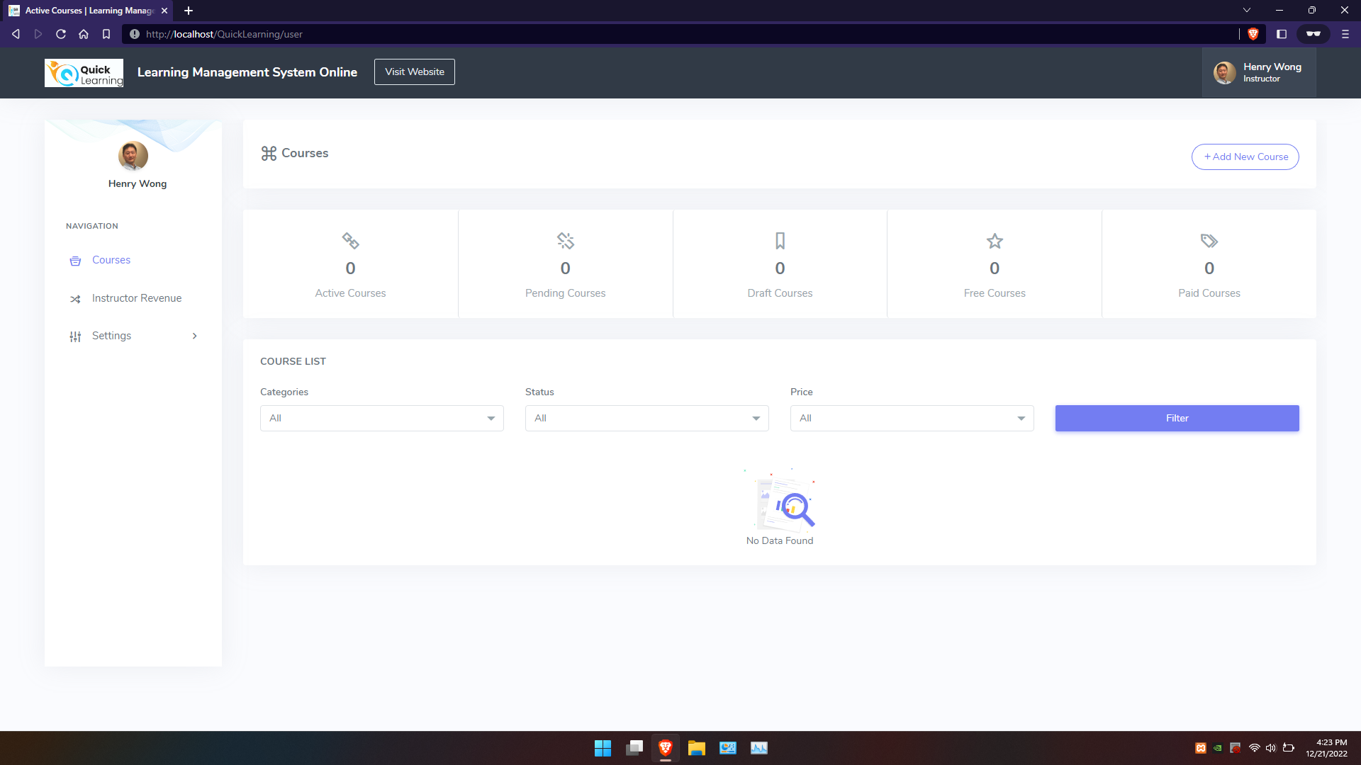
Page for Instructor

Slide 42
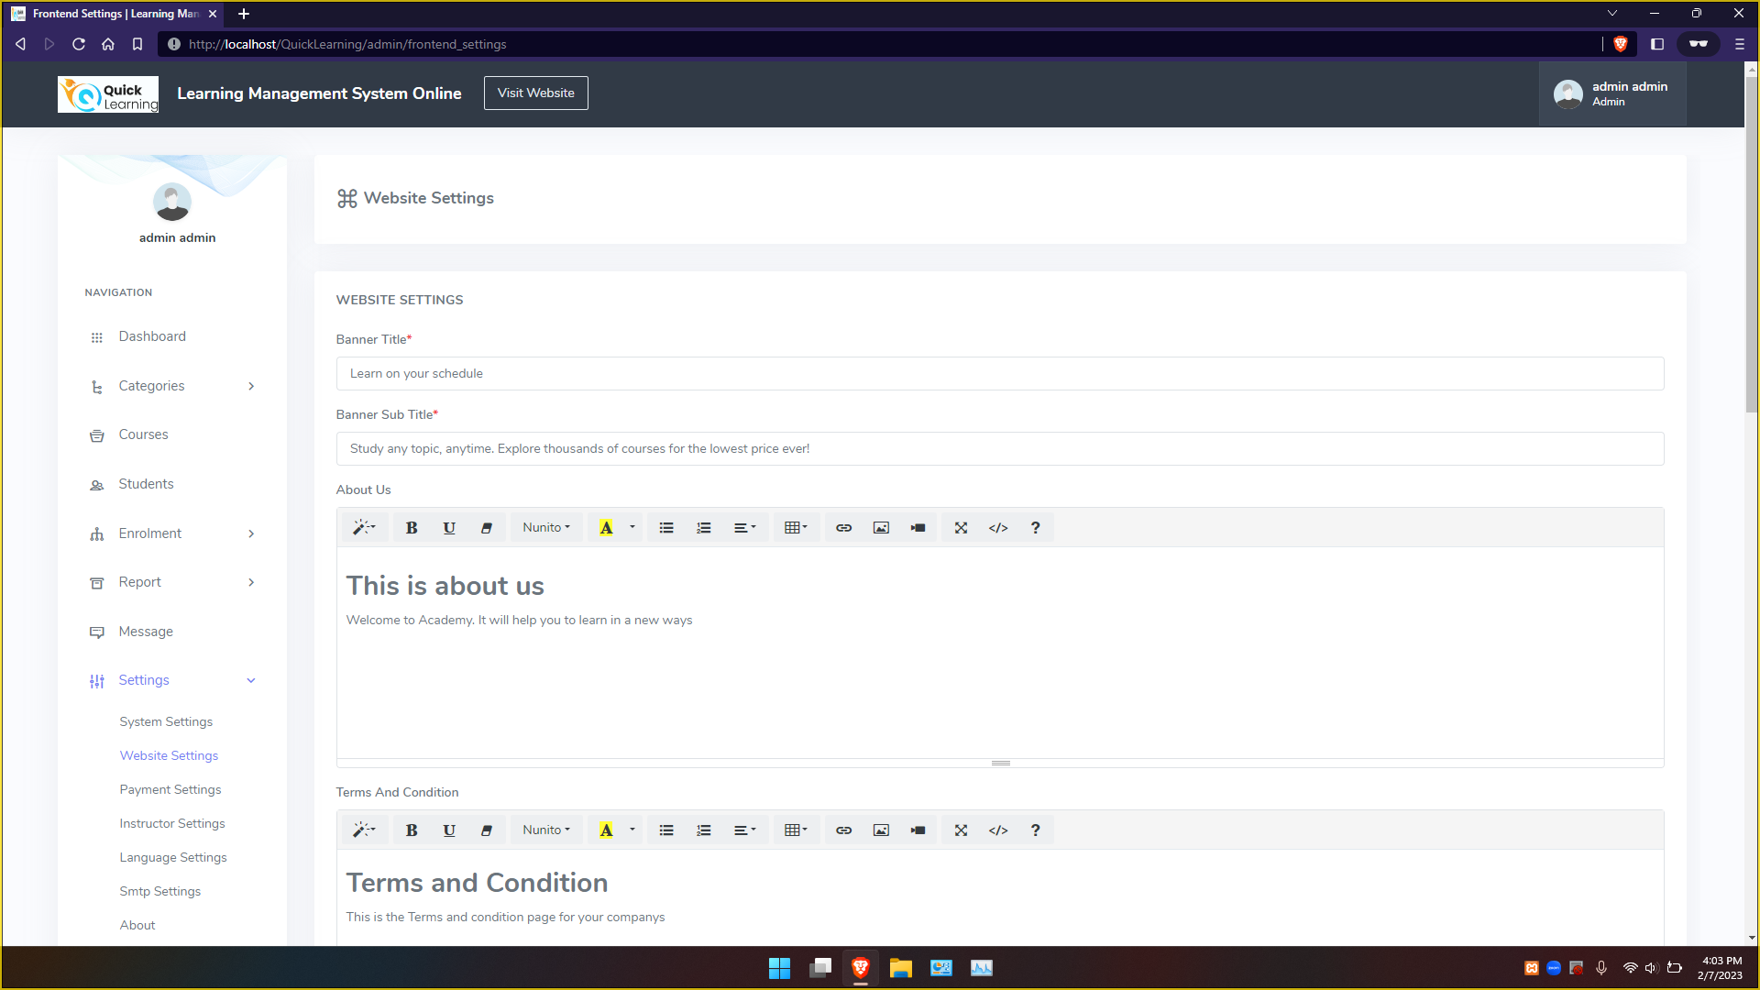
Website Settings in Admin Dashboard

Slide 43
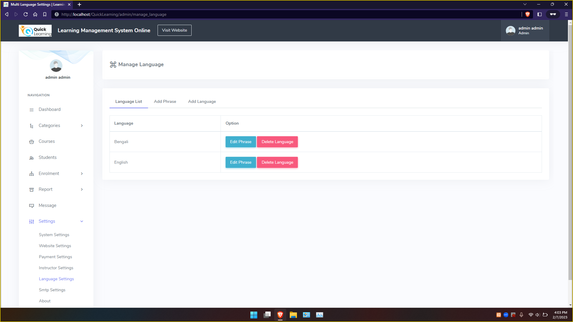
Language Settings in Admin Dashboard

Slide 44
WIKIPAGE LINK:
Click here for the WIKIPAGE

Slide 45

HAPPY LEARNING
Thank You

